Slide 1

CS1020 Data Structures and Algorithms I Lecture Note #1
Introduction to Java

Slide 2
Objectives
Java
Basic Java features
C → Java
Translate C programs in CS1010 into Java programs

Slide 3
References
Chapter 1
Section 1.1 (excludes Arrays) to Section 1.5: pages 27 to 45
CS1020 website → Resources → Lectures
http://www.comp.nus.edu.sg/ ~cs1020/2_resources/lectures.html
Section 1.7 (excludes Console class): pages 73 to 77
[CS1020 Lecture 1: Intro to Java]

Slide 4
Outline
Java: Brief history and background
Run cycle
Basic program structure
Basic Java elements
4.1 Arithmetic Expressions
4.2 Control Flow Statements and Logical Expressions
4.3 Basic Input (Scanner class) and Output
4.4 API
4.5 Math class, Class Attributes
4.6 User-defined Functions
[CS1020 Lecture 1: Intro to Java]

Slide 5

Our assumptions!
You have taken CS1010 (or equivalent) and have passed it; or
You have prior programming experience equivalent to CS1010
Hence, you are proficient in some programming language at a level expected of someone who has taken and passed CS1010 (or equivalent)
If you want to recapitulate/find out what is covered in CS1010, the lecture notes and programs are available on CS1020 module website → Misc → CS1010 Stuffs
http://www.comp.nus.edu.sg/~cs1020/4_misc/cs1010_lect.html
[CS1020 Lecture 1: Intro to Java]

Slide 6
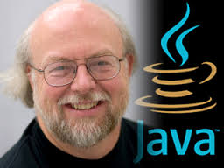
1. Java: Brief History & Background
James Gosling
1995, Sun Microsystems
Use C/C++ as foundation
“Cleaner” in syntax
Less low-level machine interaction
▪ Write Once, Run EverywhereTM
▪ Extensive and well documented standard library
▪ Less efficient
[CS1020 Lecture 1: Intro to Java]

Slide 7
Recap: Process
2. Run Cycle
Writing
Tool: Editor
Compiling
Tool: Compiler
Executing
Tool: None
Produce: Source Code
Produce: Executable Bytecode
Produce: Result
Compilation Error
Runtime Error
Logic Error
[CS1020 Lecture 1: Intro to Java]

Slide 8
Recap: Run Cycle for C Programs
2. Run Cycle
Writing/Editing Program
Use an editor, e.g.: vim
Source code must have a .c extension
Compiling Program
Use a C compiler, eg: gcc
Default executable file: a.out
Executing Binary
Type name of executable file
vim welcome.c
welcome.c
gcc -Wall welcome.c
a.out
a.out
output
[CS1020 Lecture 1: Intro to Java]

Slide 9
Java: Compile Once, Run Anywhere?
2. Run Cycle
Normal executable files are directly dependent on the OS/Hardware
Hence, an executable file is usually not executable on different platforms
E.g: The a.out file compiled on sunfire is not executable on your Windows computer
Java overcomes this by running the executable on an uniform hardware environment simulated by software
The hardware environment is know as the Java Virtual Machine (JVM)
So, we only need a specific JVM for a particular platform to execute all Java bytecodes without recompilation
[CS1020 Lecture 1: Intro to Java]

Slide 10
Run Cycle for Java Programs
2. Run Cycle
Writing/Editing Program
Use an text editor, e.g: vim
Source code must have .java extension
Compiling Program
Use a Java compiler, e.g.: javac
Compiled binary has .class extension
The binary is also known as Java Executable Bytecode
Executing Binary
Run on a Java Virtual Machine (JVM)
e.g.: java HelloWorld (leave out the .class extension)
Note the difference here compared to C executable
vim HelloWorld.java
HelloWorld.java
javac HelloWorld.java
HelloWorld.class
java HelloWorld
output
[CS1020 Lecture 1: Intro to Java]

Slide 11
Java Execution Illustration
2. Run Cycle
a.out
Normal executable (e.g.: C programs) are tied to a specific platform (OS + Hardware)
This a.out cannot work in a machine of different architecture.
Windows 7 on Core 2
HelloWorld.class
JVM provides a uniform environment for Java bytecode execution.
Java Virtual Machine
Windows 7 on Core 2
They are the same portable file.
HelloWorld.class
Java Virtual Machine
MacOS on PowerPC
[CS1020 Lecture 1: Intro to Java]

Slide 12
3. Basic Java Program Structure
Today: just the basic language components:
Basic Program Structure
Primitive data types and simple variables
Control flow (selection and repetition statements)
Input/output statements
Purpose: ease you into the language
You can attempt to “translate” some simple C programs done in CS1010 into Java
We will gradually cover many other Java features over the next few weeks
[CS1020 Lecture 1: Intro to Java]

Slide 13
Hello World!
C
#include <stdio.h>
int main(void) {
printf("Hello World!\n");
return 0;
}
3. Basic Structure
HelloWorld.c
Java
import java.lang.*; // optional
public class HelloWorld {
public static void main(String[] args) {
System.out.println("Hello World!");
}
}
Beginners’ common mistake:
Public class name not identical to program’s file name.
HelloWorld.java
[CS1020 Lecture 1: Intro to Java]

Slide 14

When you see this icon at the top right corner of the slide, it means that in the interest of time the slide might be skipped over in lecture and hence is intended for your own reading.
[CS1020 Lecture 1: Intro to Java]
14

Slide 15
Key Observations (1/2)
Library in Java is known as package
Packages are organized into hierarchical grouping
E.g., the “System.out.println()” is defined in the “java.lang.System”
i.e. “lang” (language) is a package under “java” (the main category) and “System” is a class under “lang”
To use a predefined library, the appropriate package should be imported:
Using the “import XXXXXX;” statement
All packages under a group can be imported with a “*” (the wildcard character)
Packages under “java.lang” are imported by default
Hence, the import statement in this example is optional
3. Basic Structure
[CS1020 Lecture 1: Intro to Java]

Slide 16
Key Observations (2/2)
The main() method (function) is now enclosed in a “class”
More about class will be explained in lecture 2
There should be only one main() method in a program, which serves as the execution starting point
A source code file may contain one or more classes
There are restrictions which will be explained later – this is a bit too advanced at this point
For the moment, we will restrict ourselves to one class per source code
Each class will be compiled into a separate XXXX.class bytecode
The “XXXX” is taken from the class name (“HelloWorld” in this example)
3. Basic Structure
[CS1020 Lecture 1: Intro to Java]

Slide 17
4.1 Arithmetic Expressions

Slide 18
4.1 Identifier, Variable, Constant (1/2)
Identifier is a name that we associate with some program entity (class name, variable name, parameter name, etc.)
Java Identifier Rule:
May consist of letters (‘a’ – ‘z’, ‘A’ – ‘Z’), digit characters (‘0’ – ‘9’), underscore (_) and dollar sign ($)
Cannot begin with a digit character
Variable is used to store data in a program
A variable must be declared with a specific data type
Eg:
int countDays;
double priceOfItem;
[CS1020 Lecture 1: Intro to Java]

Slide 19
4.1 Identifier, Variable, Constant (2/2)
Constant is used to represent a fixed value
Eg:
Keyword final indicates that the value cannot change
Guidelines on how to name classes, variables, and constants: see CS1020 website → Resources → Online:
http://www.comp.nus.edu.sg/~cs1020/2_resources/online.html
Class name: UpperCamelCase
Eg: Math, HelloWorld, ConvexGeometricShape
Variable name: LowerCamelCase
Eg: countDays, innerDiameter, numOfCoins
Constant: All uppercase with underscore
Eg: PI, CONVERSION_RATE, CM_PER_INCH
public static final int PASSING_MARK = 65;
[CS1020 Lecture 1: Intro to Java]

Slide 20
4.1 Numeric Data Types
Summary of numeric data types in Java:
Type Name | Size (#bytes) | Range
byte | 1 | -2⁷ to 2⁷-1
short | 2 | -2¹⁵ to 2¹⁵-1
int | 4 | -2³¹ to 2³¹-1
long | 8 | -2⁶³ to 2⁶³-1
float | 4 | Negative: -3.4028235E+38 to -1.4E-45 Positive: 1.4E-45 to 3.4028235E+38
double | 8 | Negative: -1.7976931348623157E+308 to -4.9E-324 Positive: 4.9E-324 to 1.7976931348623157E+308
Integer Data Types
Floating- Point Data Types
Unless otherwise stated, you are to use:
int for integers
double for floating-point numbers
[CS1020 Lecture 1: Intro to Java]

Slide 21
4.1 Numeric Operators
() | Parentheses Grouping | Left-to-right
++, -- | Postfix incrementor/decrementor | Right-to-left
++, -- +, - | Prefix incrementor/decrementor Unary +, - | Right-to-left
*, /, % | Multiplication, Division, Remainder of division | Left-to-right
+, - | Addition, Subtraction | Left-to-right
= += -= *= /= %= | Assignment Operator Shorthand Operators | Right-to-left
Higher Precedence
Evaluation of numeric expression:
Determine grouping using precedence
Use associativity to differentiate operators of same precedence
Data type conversion is performed for operands with different data type
[CS1020 Lecture 1: Intro to Java]

Slide 22
4.1 Numeric Data Type Conversion
When operands of an operation have differing types:
If one of the operands is double, convert the other to double
Otherwise, if one of them is float, convert the other to float
Otherwise, if one of them is long, convert the other to long
Otherwise, convert both into int
When value is assigned to a variable of differing types:
Widening (Promotion):
Value has a smaller range compared to the variable
Converted automatically
Narrowing (Demotion):
Value has a larger range compared to the variable
Explicit type casting is needed
[CS1020 Lecture 1: Intro to Java]

Slide 23
4.1 Data Type Conversion
Conversion mistake:
double d;
int i;
i = 31415;
d = i / 10000;
What’s the mistake? How do you correct it?
Q: What is assigned to d?
The (int) d expression is known as type casting
Syntax:
(datatype) value
Effect:
value is converted explicitly to the data type stated if possible.
Type casting:
double d;
int i;
d = 3.14159;
i = (int) d; // i is assigned 3
Q: What is assigned to i if d contains 3.987 instead?

[CS1020 Lecture 1: Intro to Java]

Slide 24
4.1 Problem: Fahrenheit to Celsius
Write a simple Java program Temperature.Java:
To convert a temperature reading in Fahrenheit, a real number, to Celsius degree using the following formula:
Print out the result
For the time being, you can hard code a value for the temperature in Fahrenheit instead of reading it from user
[CS1020 Lecture 1: Intro to Java]

Slide 25
4.1 Solution: Fahrenheit to Celsius
Temperature.java
public class Temperature {
public static void main(String[] args) {
double fahrenheit, celsius;
fahrenheit = 123.5;
celsius = (5.0/9) * (fahrenheit – 32);
System.out.println("Celsius: " + celsius);
}
}
Output:
Celsius: 50.833333333333336
Compare with C:
printf("Celsius: %f\n", celsius);
Notes:
5.0/9 is necessary to get the correct result (what will 5/9 give?)
“+” in the printing statement
Concatenate operator, to combine strings into a single string
Variable values will be converted to string automatically
There is another printing statement, System.out.print(), which does not include newline at the end of line (more in section 4.3)
[CS1020 Lecture 1: Intro to Java]

Slide 26
4.2 Control Statements
Program Execution Flow

Slide 27
4.2 Boolean Data Type [new in Java]
Java provides an actual boolean data type
Store boolean value true or false, which are keywords in Java
Boolean expression evaluates to either true or false
SYNTAX
boolean variable;
Example
boolean isEven;
int input;
// code to read input from user omitted
if (input % 2 == 0)
isEven = true;
else
isEven = false;
if (isEven)
System.out.println("Input is even!");
Equivalent:
isEven = (input % 2 == 0);
[CS1020 Lecture 1: Intro to Java]

Slide 28
4.2 Boolean Operators
 | Operators | Description
Relational Operators | < | less than
 | > | larger than
 | <= | less than or equal
 | >= | larger than or equal
 | == | Equal
 | != | not equal
Logical Operators | && | and
 | || | or
 | ! | not
 | ^ | exclusive-or
Operands are variables / values that can be compared directly.
Examples:
X < Y
1 >= 4
Operands are boolean variables/expressions.
Examples:
(X < Y) && (Y < Z)
(!isEven)
[CS1020 Lecture 1: Intro to Java]

Slide 29
4.2 Comparison with C
In ANSI C, there is no boolean type.
Zero means ‘false’ and any other value means ‘true’
int x;
... // assume x is assigned a non-negative value
if (x%3)
printf("%d is not divisible by 3.\n", x);
else
printf("%d is divisible by 3.\n", x);
In Java, the above is invalid
Java code:
int x;
... // assume x is assigned a non-negative value
if (x%3 != 0)
System.out.println(x + " is not divisible by 3.");
else
System.out.println(x + " is divisible by 3.");
[CS1020 Lecture 1: Intro to Java]

Slide 30
4.2 Selection Statements
if (a > b) {
...
}
else {
...
}
if-else statement
else-part is optional
Condition:
Must be a boolean expression
Unlike C, integer values are NOT valid
switch (a) {
case 1:
... break;
case 2:
case 3:
...
default:
}
switch-case statement
Expression in switch() must evaluate to a value of char, byte, short or int type
break: stop the fall-through execution
default: catch all unmatched cases; may be optional
[CS1020 Lecture 1: Intro to Java]
30

Slide 31
4.2 Repetition Statements (1/2)
Valid conditions:
Must be a boolean expression
while : check condition before executing body
do-while: execute body before condition checking
while (a > b) {
... //body
}
do {
... //body
} while (a > b);
A: initialization (e.g. i = 0)
B: condition (e.g. i < 10)
C: update (e.g. i++)
Any of the above can be empty
Execution order:
A, B, body, C, B, body, C, …
for (A; B; C) {
... //body
}
[CS1020 Lecture 1: Intro to Java]

Slide 32
4.2 Repetition Statements (2/2)
In ANSI C, the loop variable must be declared before it is used in a ‘for’ loop
int i;
for (i=0; i<10; i++) {
...
}
In Java, the loop variable may be declared in the initialisation part of the ‘for’ loop
In example below, the scope of variable i is within the ‘for’ loop only
for (int i=0; i<10; i++) {
...
}
[CS1020 Lecture 1: Intro to Java]

Slide 33
4.3 Basic Input/Output
Interacting with the outside world

Slide 34
4.3 Reading input: The Scanner Class
PACKAGE
import java.util.Scanner;
SYNTAX
//Declaration of Scanner "variable"
Scanner scVar = new Scanner(System.in);
//Functionality provided
scVar.nextInt();
scVar.nextDouble();
......
Read an integer value from source System.in
Read a double value from source System.in
Other data types, to be covered later
[CS1020 Lecture 1: Intro to Java]

Slide 35
4.3 Reading Input: Fahrenheit Ver 2
import java.util.Scanner; // or import java.util.*;
public class TemperatureInteractive {
public static void main(String[] args) {
double fahrenheit, celsius;
Scanner sc = new Scanner(System.in);
System.out.print("Enter temperature in Fahrenheit: ");
fahrenheit = sc.nextDouble();
celsius = (5.0/9) * (fahrenheit – 32);
System.out.println("Celsius: " + celsius);
}
}
TemperatureInteractive.java
[CS1020 Lecture 1: Intro to Java]

Slide 36
4.3 Reading Input: Key Points (1/3)
The statement
Scanner sc = new Scanner(System.in);
Declares a variable “sc” of Scanner type
The initialization “new Scanner(System.in)”
Constructs a Scanner object
We will discuss more about object later
Attaches it to the standard input “System.in” (which is the keyboard)
This Scanner object sc will receive input from this source
Scanner can attach to a variety of input sources; this is just a typical usage
[CS1020 Lecture 1: Intro to Java]

Slide 37
4.3 Reading Input: Key Points (2/3)
After proper initialization, a Scanner object provides functionality to read value of various types from the input source
The statement
fahrenheit = sc.nextDouble();
nextDouble() works like a function (called method in Java) that returns a double value read interactively
The Scanner object sc converts the input into the appropriate data type and returns it
in this case, user input from the keyboard is converted into a double value
[CS1020 Lecture 1: Intro to Java]

Slide 38

4.3 Reading Input: Key Points (3/3)
Typically, only one Scanner object is needed, even if many input values are to be read.
The same Scanner object can be used to call the relevant methods to read input values
In CodeCrunch, your program will NOT work if you use more than one Scanner object with System.in as input stream.
[CS1020 Lecture 1: Intro to Java]

Slide 39
4.3 Writing Output: The Standard Output
System.out is the predefined output device
Refers to the monitor/screen of your computer
SYNTAX
//Functionality provided
System.out.print( output_string );
System.out.println( output_string );
System.out.printf( format_string, [items] );
System.out.print("ABC");
System.out.println("DEF");
System.out.println("GHI");
System.out.printf("Very C-like %.3f\n", 3.14159);
Output:
ABCDEF
GHI
Very C-like 3.142
[CS1020 Lecture 1: Intro to Java]

Slide 40
4.3 Writing Output: printf()
Java introduces printf() in Java 1.5
Very similar to the C version
The format string contains normal characters and a number of specifiers
Specifier starts with a percent sign (%)
Value of the appropriate type must be supplied for each specifier
Common specifiers and modifiers:
%d | for integer value
%f | for double floating-point value
%s | for string
%b | for boolean value
%c | for character value
SYNTAX
%[-][W].[P]type
-: For left alignment
W: For width
P: For precision
[CS1020 Lecture 1: Intro to Java]

Slide 41
4.3 Problem: Approximating PI
One way to calculate the PI (π) constant:
Write ApproximatePI.java to:
Ask the user for the number of terms to use for approximation
Calculate π with the given number of terms
Output the approximation in 6 decimal places
[CS1020 Lecture 1: Intro to Java]

Slide 42
4.3 Solution: Approximating PI
import java.util.*; // using * in import statement
public class ApproximatePI {
public static void main(String[] args) {
int nTerms, sign = 1, denom = 1;
double pi = 0.0;
Scanner sc = new Scanner(System.in);
System.out.print("Enter number of terms: ");
nTerms = sc.nextInt();
for (int i = 0; i < nTerms; i++) {
pi += 4.0 / denom * sign;
sign *= -1;
denom += 2;
}
System.out.printf("PI = %.6f\n", pi);
}
}
ApproximatePI.java
[CS1020 Lecture 1: Intro to Java]

Slide 43
4.4 API
Application Programming Interface

Slide 44

4.4 API (1/2)
The Scanner class you have seen is part of the Java API
API: an interface for other programs to interact with a program without having direct access to the internal data of the program
Documentation, SE7: http://docs.oracle.com/javase/7/docs/api/
You may also access the above link through CS1020 website → Resources → Online (http://www.comp.nus.edu.sg/~cs1020/2_resources/online.html)
For Java programmers, it is very important to refer to the API documentation regularly!
The API consists of many classes
You do not need to know all the classes (there are easily a few thousand classes altogether!)
You will learn some more classes in this course
This week reading assignment
Read up Scanner class in the API documentation
[CS1020 Lecture 1: Intro to Java]

Slide 45
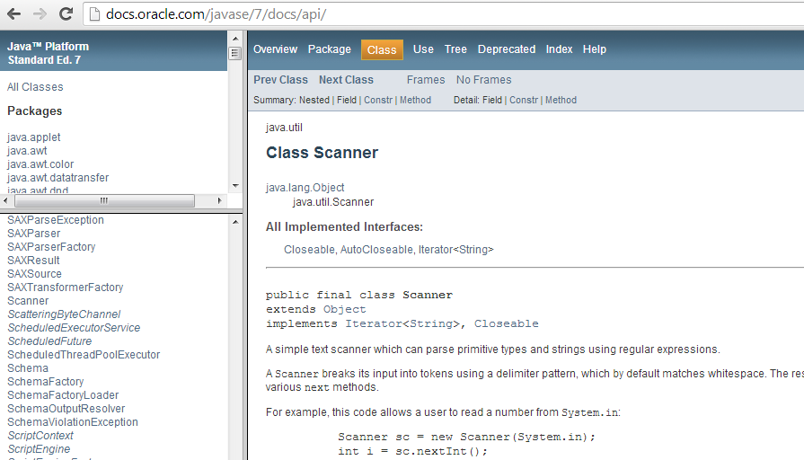
4.4 API (2/2)
[CS1020 Lecture 1: Intro to Java]

Slide 46
4.5 Math class, Class Attributes
Using the Math class

Slide 47
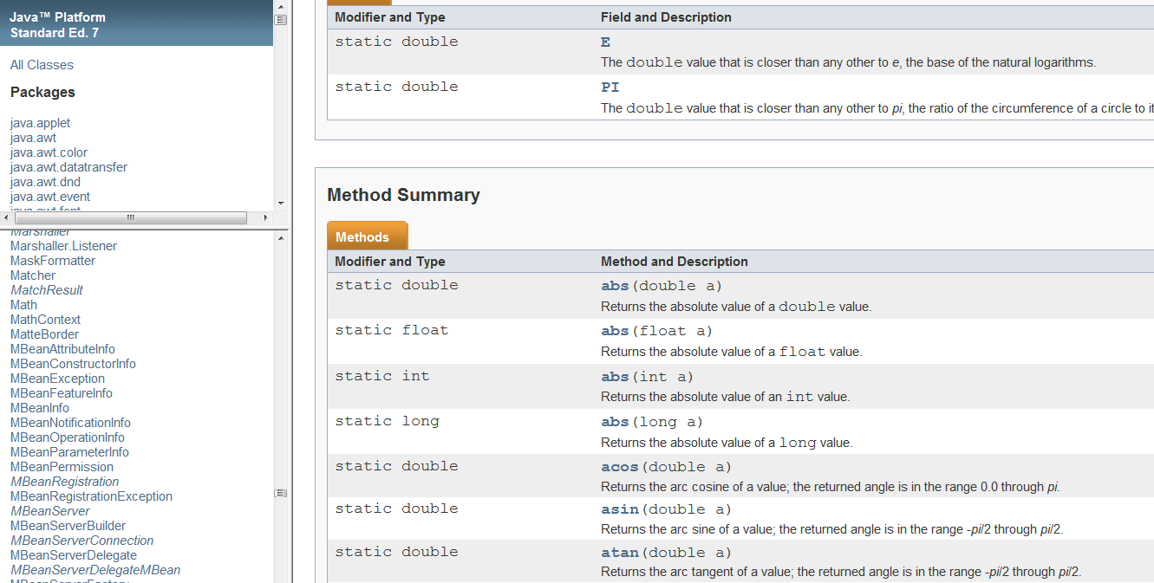
4.5 The Math class (1/2)
From the API documentation
[CS1020 Lecture 1: Intro to Java]

Slide 48
4.5 The Math class (2/2)
Package: java.lang (default)
Some useful Math methods:
abs()
ceil()
floor()
max()
min()
pow()
random()
sqrt()
[CS1020 Lecture 1: Intro to Java]

Slide 49
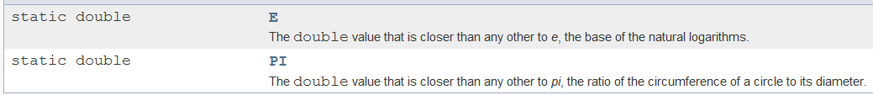
4.5 Class Attributes
The Math class has two class attributes
A class attribute (or class member) is associated with the class, not the individual instances (objects). Every instance of a class shares the class attribute.
We will explain about “objects” later.
How to use it?
Example: double area = Math.PI * Math.pow(radius,2);
Here, Math.PI is used as the constant π
[CS1020 Lecture 1: Intro to Java]

Slide 50
4.5 The Math class: Demo
TestMath.java
// To find the area of the largest circle inscribed
// inside a square, given the area of the square.
import java.util.*;
public class TestMath {
public static void main(String[] args) {
Scanner sc = new Scanner(System.in);
System.out.print("Enter area of a square: ");
double areaSquare = sc.nextDouble();
double radius = Math.sqrt(areaSquare)/2;
double areaCircle = Math.PI * Math.pow(radius, 2);
System.out.printf("Area of circle = %.4f\n",
areaCircle);
}
}
radius
[CS1020 Lecture 1: Intro to Java]

Slide 51
4.6 User-defined Functions
Reusable and independent code units

Slide 52
4.6 Function with a new name
In Java, C-like function is known as static/class method
Denoted by the “static” keyword before return data type
Another type of method, known as instance method will be covered later
Factorial.java
public class Factorial {
// Returns n!
// Pre-cond: n >= 0
public static int factorial (int n) {
if (n == 0) return 1;
else return n * factorial(n-1);
}
public static void main(String[] args) {
int n = 5; // You can change it to interactive input
System.out.printf("Factorial(%d) = %d\n", n, factorial(n));
}
}
If n is too big, say 40, what will happen? Why?
[CS1020 Lecture 1: Intro to Java]

Slide 53
4.6 Method Parameter Passing
All parameters in Java are passed by value (as in C):
A copy of the actual argument is created upon method invocation
The method parameter and its corresponding actual parameter are two independent variables
In order to let a method modify the actual argument:
An object reference data type is needed (similar to pointer in C)
Will be covered later
[CS1020 Lecture 1: Intro to Java]

Slide 54
Summary
Java Elements
Data Types:
- Numeric Data Types:
byte, short, int, float, double
- Boolean Data Type:
boolean
Expressions:
- Arithmetic Expression
- Boolean Expression
Control Flow Statements:
- Selection Statements: if-else, switch-case
- Repetition Statements: while, do-while, for
Classes:
- Scanner
- Math
[CS1020 Lecture 1: Intro to Java]

Slide 55
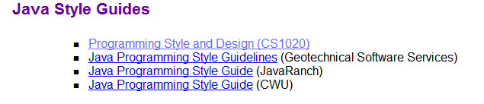
References for Java Style Guides
Important!
See CS1020 website → Resources → Online
http://www.comp.nus.edu.sg/~cs1020/2_resources/online.html
Java naming convention
Class name in UpperCamelCase
Eg: “class SumIntegers”, “class Vehicle”, “class GeometricShape”
Variable names in LowerCamelCase
Eg: “int count”, “double boxHeight”, “char checkCode”
Constant names in uppercase, words separated by underscore
Eg: “KMS_PER_MILES”, “PI”, “PASSING_MARK”
[CS1020 Lecture 1: Intro to Java]

Slide 56
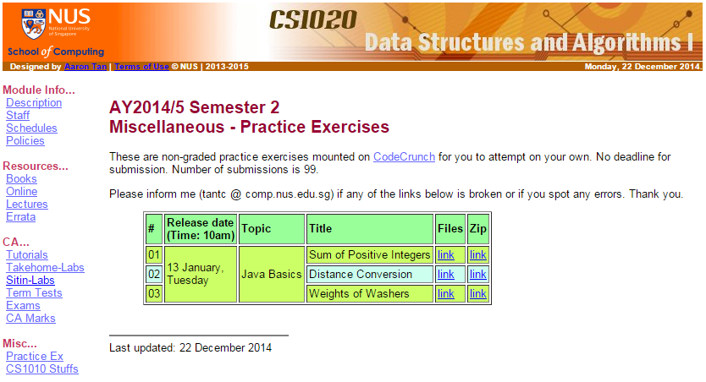
Practice Exercises
Mounted on CodeCrunch
Non-graded, no deadline, number of submissions = 99
Strongly urged to attempt them and discuss on IVLE forum
Check out CS1020 website → Misc. → Practice Ex http://www.comp.nus.edu.sg/~cs1020/4_misc/practice.html
[CS1020 Lecture 1: Intro to Java]

Slide 57
Next Week: Real OOP
This week, the Java programs shown do not truly use object-oriented programming (OOP) features
We will learn some OOP concepts next week
[CS1020 Lecture 1: Intro to Java]

Slide 58
Introductory Workshop
Those of you who have taken CS1010 are familiar with UNIX system and vim.
For those who did not take CS1010 and hence are unfamiliar with UNIX and vim, please attend an Intro Workshop on 14th January, Thursday, at PL2 (COM1 basement)
Session 1: 10am – 11:40am
Session 2: 12nn – 1:40pm
Session 3: 2 – 3:40pm
Session 4: 4 – 5:40pm
Please refer to IVLE forum “Intro Workshop” and sign up there
[CS1020 Lecture 1: Intro to Java]

Slide 59
End of file

